Slide 1
!
Just Get , What you Want

Slide 2
What we want………
Health
Wealth
Job
Family
Home
Fame
Success
Happiness

Slide 3

Be Receptive

Slide 4

This is a Secret!!!!
How do we get ?

Slide 5
Transmission of frequency:

Slide 6
This SECRET gives you everything ,You want..
We all work with one infinite power.
The Natural Law of Universe is So precise.
The secret is law of ATTRACTION.

Slide 7
How To Apply:
(1) To Ask
(2) Believe on it
(3) Get it
Example: Restaurant.

Slide 8
vki tks lksp jgs gS tks eglwl dj jgs gS ogh vkidk
Hkfo"; cuk jgk gS A
The Law of Attraction doesn’t care whether you perceive Good or Bad.
If you think ,You can do OR You cannot do. Both are RIGHT.

Slide 9
A positive thought
is the seed of a positive result.
THOUGHTS
THINGS

Slide 10
How will you find your Attitude?

Slide 11
POSITIVE ATTITUDE
Whether a glass if half-full or half-empty, depends on the attitude of the person looking at it.
The difference between a successful person and others is not a lack of knowledge, but rather a lack of will.

Slide 12
THE ICEBERG
The Iceberg phenomena is also applicable on human beings …

Slide 13
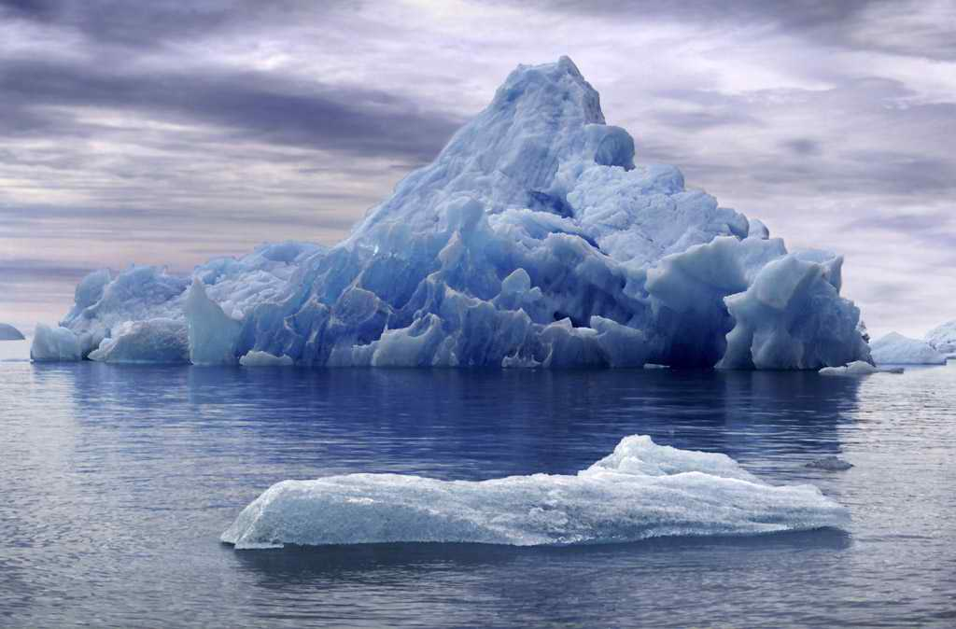

THE ICEBERG
HOW MUCH DO YOU SEE OF AN ICEBERG?

Slide 14
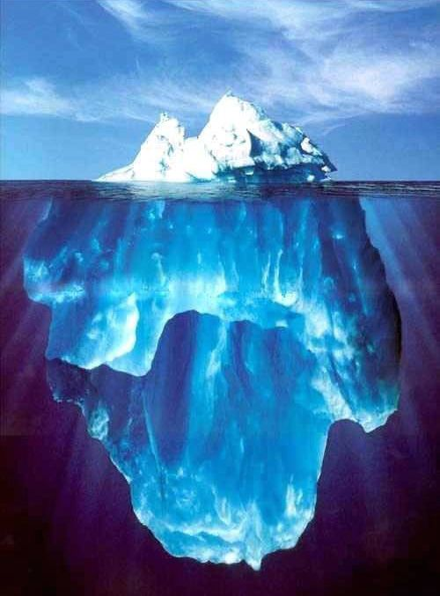
THE ICEBERG
ONLY 10% OF ANY ICEBERG IS VISIBLE. REMAINING 90% IS BELOW SEA LEVEL.

Slide 15
THE ICEBERG
10 %
VISIBLE
ABOVE SEA LEVEL
SEA LEVEL
INVISIBLE
BELOW SEA LEVEL
90 %

Slide 16
THE ICEBERG
KNOWLEDGE
&
SKILLS
KNOWN
TO OTHERS
SEA LEVEL
UNKNOWN
TO OTHERS
ATTITUDE

Slide 17
THE ICEBERG
BEHAVIOR
KNOWN
TO OTHERS
SEA LEVEL
UNKNOWN
TO OTHERS
I IMPACT
VALUES – STANDARDS – JUDGMENTS
ATTITUDE
MOTIVES – ETHICS - BELIEFS

Slide 18
Exercises to Implement:
To Feel
    Feel Happy
    Feel Satisfy
    Feel Thankful
To Imagine
    Visualize

Slide 19
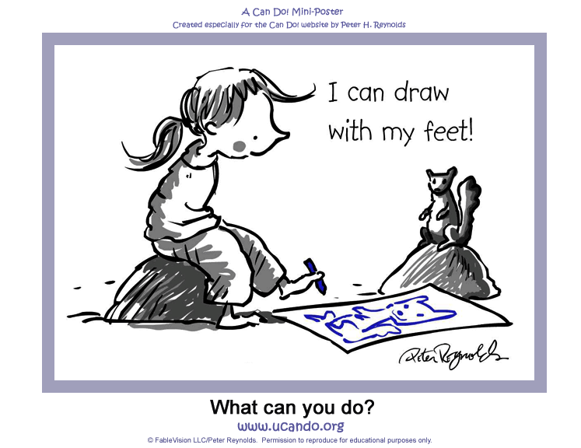
Focus On you already HAVE : Respect yourself
Exercise 1: To Feel
If you really want to be happy, nobody can stop you.

Slide 20
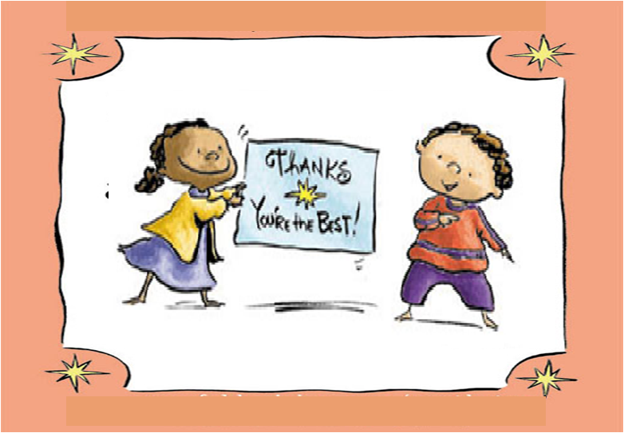
An Attitude of Gratitude

Slide 21
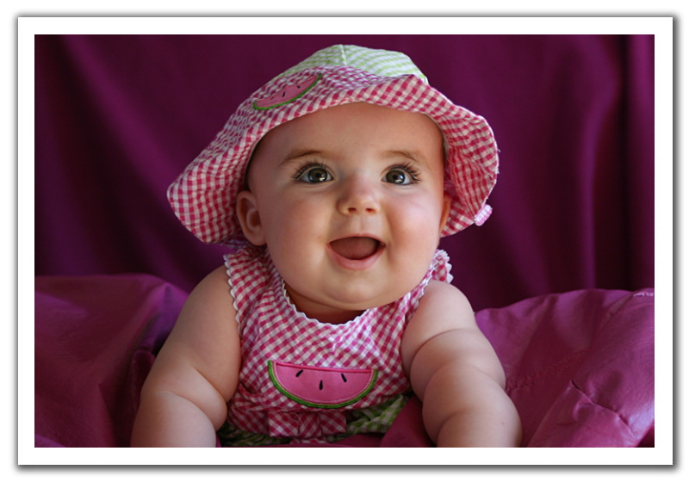
Always Feel Good:

Slide 22

Imagination is everything. It is preview of life.
Exercise 2 : To Imaginelife.
60,000 Thoughts on mind in a day.
Imagination works every second.

Slide 23

Vision Board
To Visualize:
I want to fly
I also want These

Slide 24


Slide 25

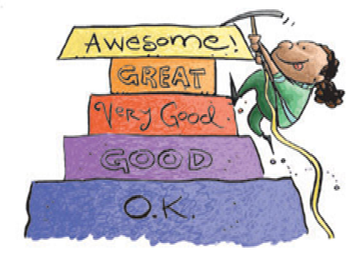
fo’okl ds igys ik;nku ij p<sa vkidks iwjs thou dks ns[kus dh t#jr ugh gSa A cl igyh lh<h p<sa A

Slide 26
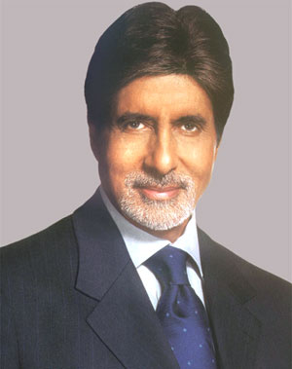
Look at him

Slide 27
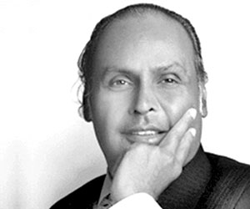
Look at him

Slide 28
In summery….
Things to remember
(1) To Ask
(2) Believe on it
(3) Get it
Be Positive
Care about your feelings
Believe on yourself
Be Thankful
Be Patient

Slide 29

Queries?

Slide 30
Thank You
Have a Great Life …

